Slide 1




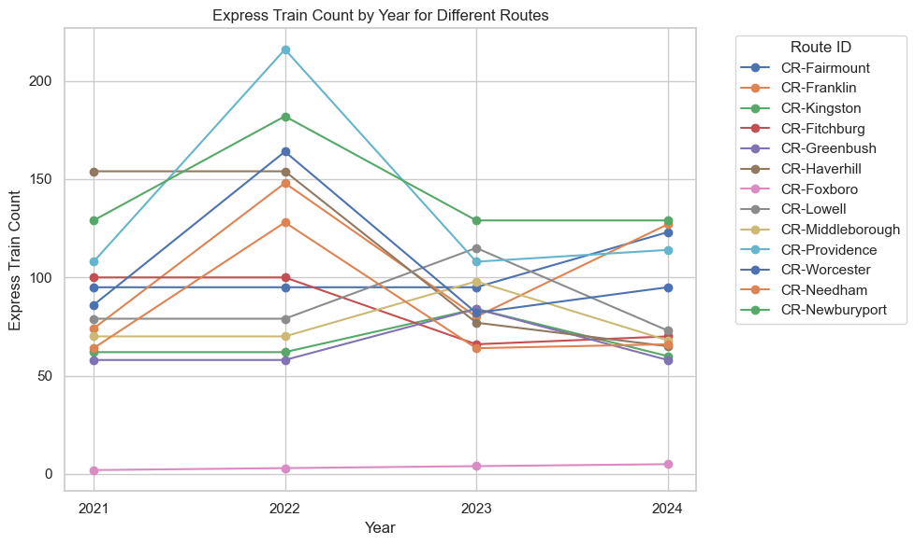
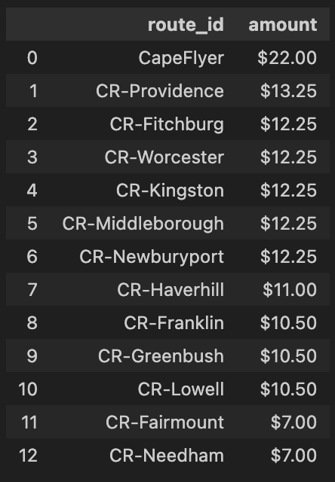
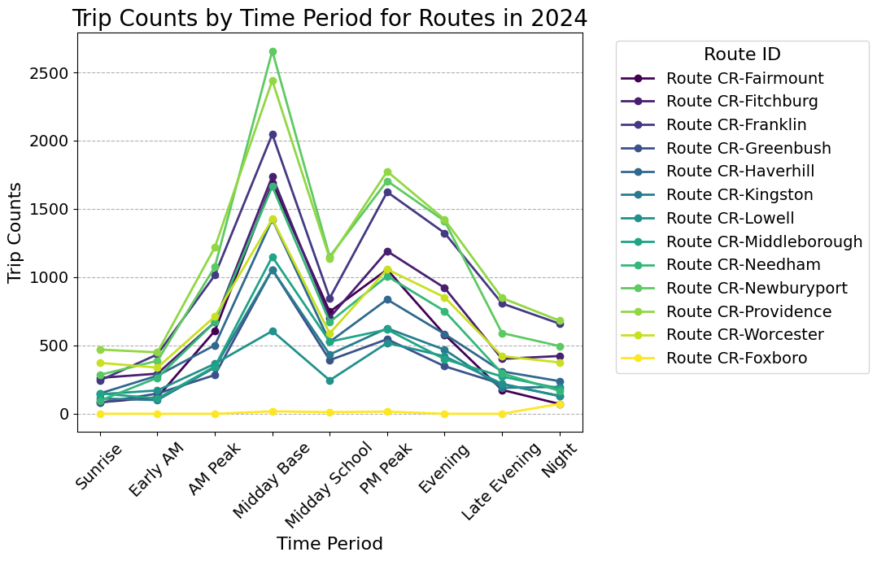

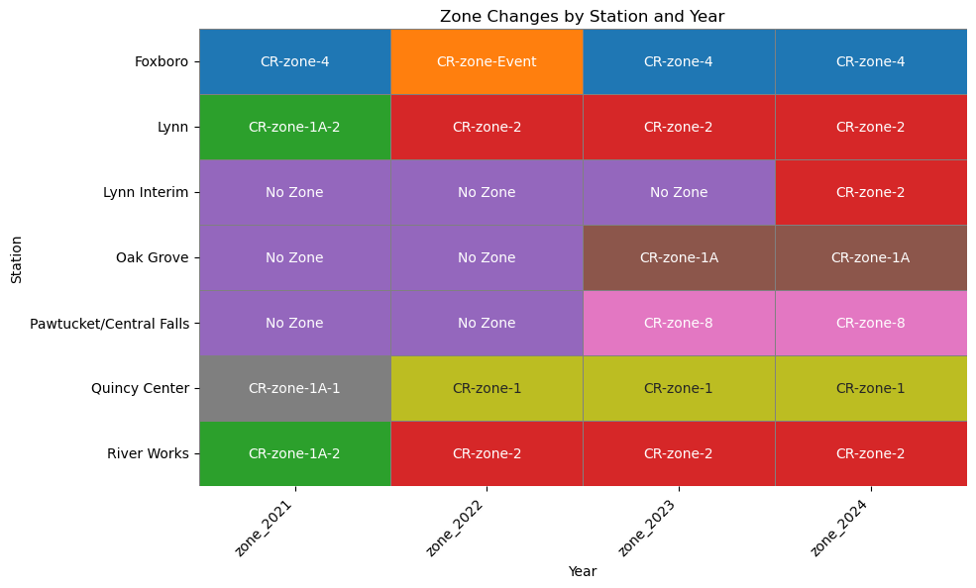
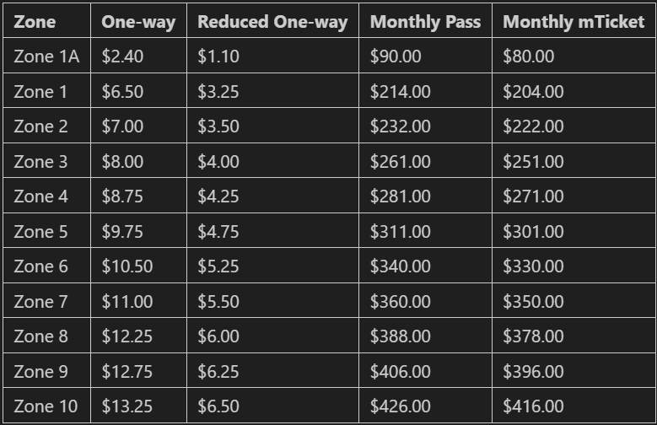
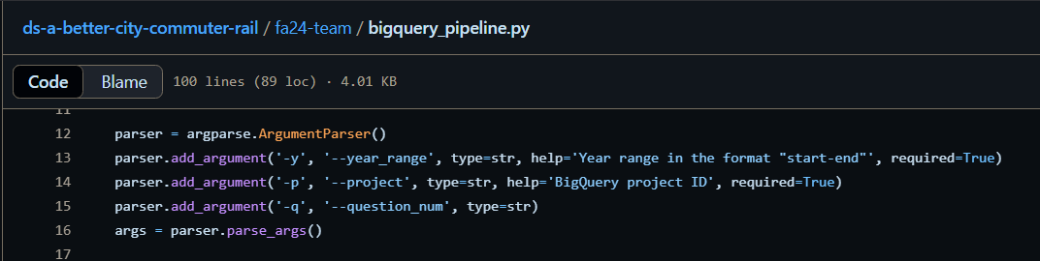
A Better City: Commuter Rail Analysis
By Bhuvan Shivalingaiah Gowda (bhuvansg@bu.edu)
Neel Gangrade
Ningxin Guan(nxguan@bu.edu)
Sumanth Hosdurg Kamath (sumanth@bu.edu)
Yuanchen Yin (yinthyg@bu.edu)
Introduction
Data Analysis
The number of express train for each line
The project aims to create a comprehensive data repository and analysis framework for Massachusetts Bay Transportation Authority schedules, focusing on both current and historical data. This initiative will support policy-making and decarbonization strategies.
Client: A Better City represents a multi-sector group of nearly 130 business leaders united around a common goal: to enhance the Greater Boston region’s economic health, competitiveness, equitable growth, sustainability, and quality of life for all communities.
Can we compare the changes in fare cost over time?
The output graph shows the number of express trips on each commuter rail line from 2021 to 2024. The y axis represents the trip counts and the x axis represents the years.
Since we have data for fares for 2 years (i.e, 2023 and 2024), we do not see any change in fares over the time.
This table depicts the fare cost to travel from Boston to the last station of each line.
NOTE - CapeFLYER is a seasonal train route that runs between South Station and Hyannis from Memorial Day to Labor Day. So we can see a significant rise in the CapeFlyer route fare. The fares in other routes are calculated using the difference in farezone_areas.
Data and methods
As shown in the graph, 2022 has the highest number of express trains compared to other years. The line Providence, Kingston, Worcester, Needham, Fitchburg all have a decrease in number of express trips from 2022 to 2023. Line Foxboro has the lowest number of express trains and has a slow increase from 2021 to 2024.
Dataset Description
A breakdown of trains by time of day (early morning, peak morning, midday, afternoon peak, evening, late night)
The dataset originated from the MBTA archives and is scraped for the latest version for each season and year. The scraped URL contains 31 tables containing information on routes, lines, schedules, trips, fares, etc. which helps analyze each project question. This raw dataset is also uploaded to BigQuery for feasible preprocessing and analysis.
We define different times of the day by the following time period in the time_of_day(time_str) function: AM Peak: 6:00 AM - 9:00 AM, PM Peak: 5:00 PM - 7:00 PM, Midday Base: 9:00 AM - 4:00 PM, Early AM: 5:00 AM - 6:00 AM, Late Evening: 8:00 PM - 11:00 PM, Night: 11:00 PM - 5:00 AM, Sunrise: 5:00 AM - 6:00 AM, and Midday School: 12:00 PM - 2:00 PM.
Do we see incidents of a station changing fare zones?
Data Cleaning
This visualization shows the stations on the y-axis and the years on the x-axis. We can clearly see that after 2022, all stations have a consistency in their fare zones. The reason behind that is the end of the COVID-19 pandemic as we moved from 2021 to 2022. There is also a special fare zone called ‘CR-zone-Event’ which is only introduced at the times of major events in Boston to redirect the crowd going to the event and ensure a smoother service for everyone in the city.
focus on commuter rail information: filtering rows where the route_desc column equals "commuter_rail".
Remove null values.
Remove duplicate values.
From the Trip Counts by Time Period graph, it is evident that for every commuter rail line, the Midday Base period usually has the highest number of trips, followed by the PM peak. This indicates a strong ridership demand during the morning and evening rush hour. In contrast, there are significantly fewer trips during sunrise and late night. This pattern is aligned with the typical daily travel behavior.
There is an exception to this pattern. In the graph of the CR Lowell line, Worcester line, and Fitchburg line, 2019 has the most number of trips. There are several reasons that may contribute to this change. In 2020, some commuter rail lines such as the Lowell line underwent infrastructure improvement, which could result in decreases of trip numbers.
Pipeline to Upload Raw Data to BigQuery
The bigquery_pipeline.py script can be used to upload all the raw data for each season year from the MBTA archives to BigQuery.
python bigquery_pipeline.py --year_range 2019-2024 --project ds-better-city-commuter
Your Commuter Rail fare depends on which Zones your boarding and exiting stations are located in.

Slide 2
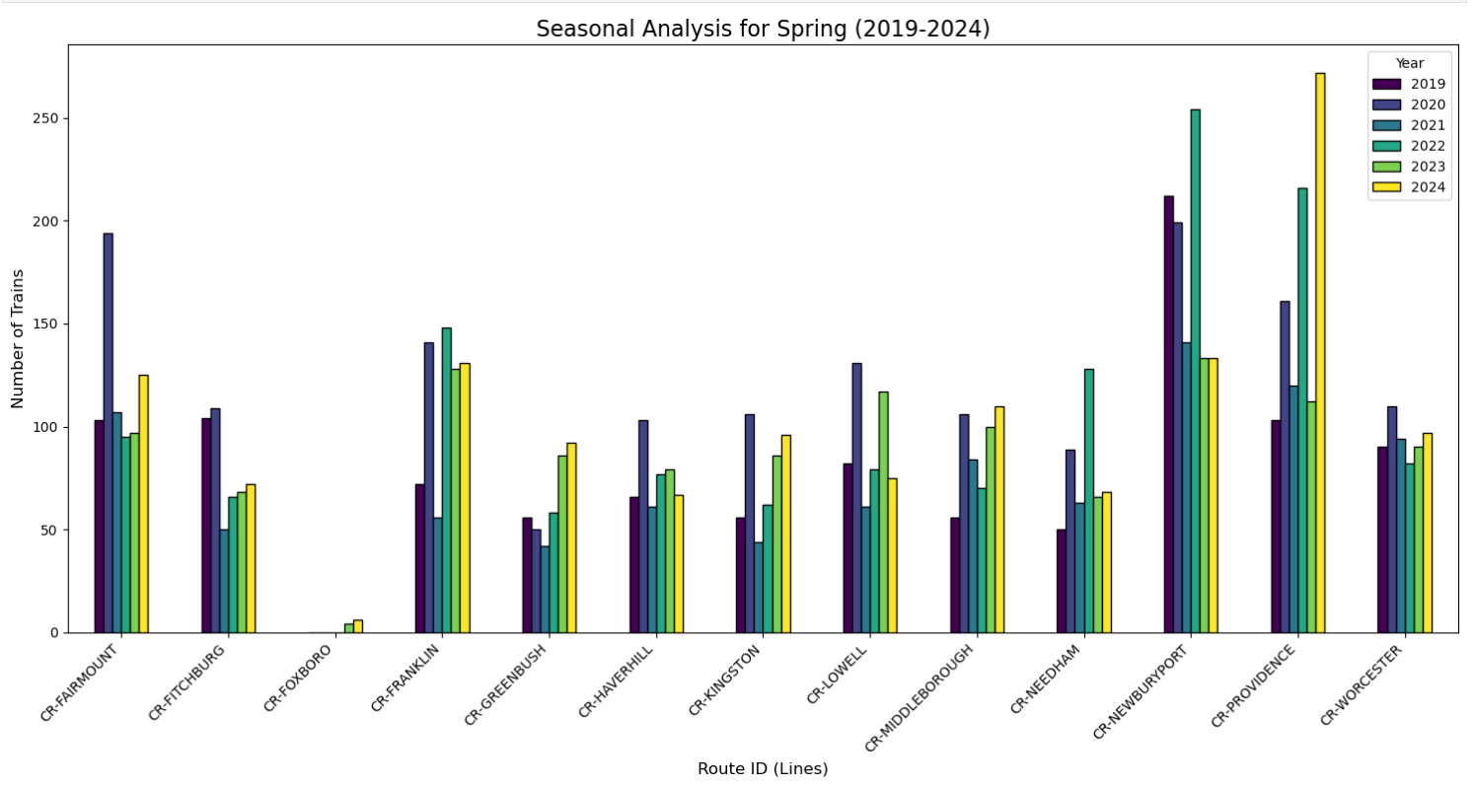
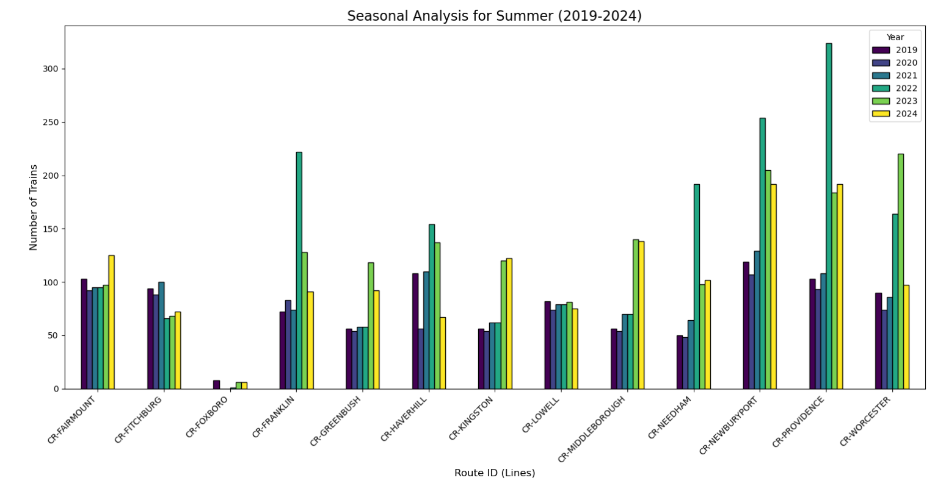
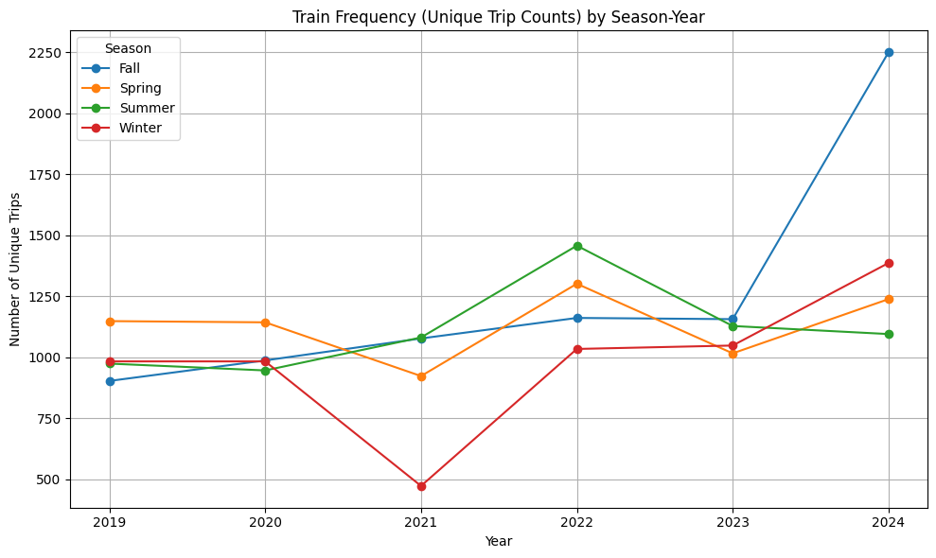
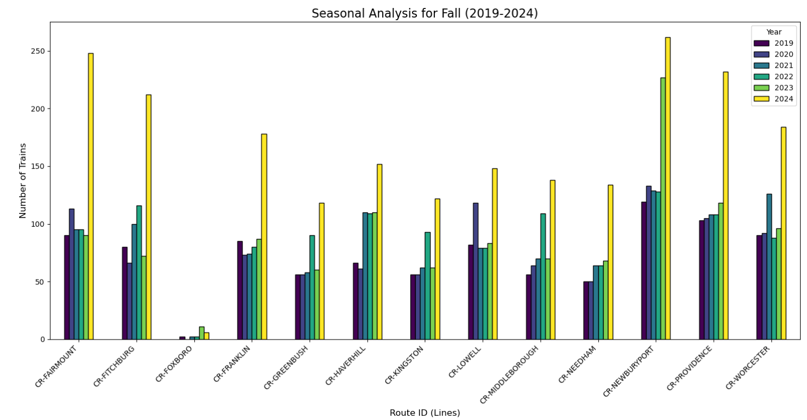
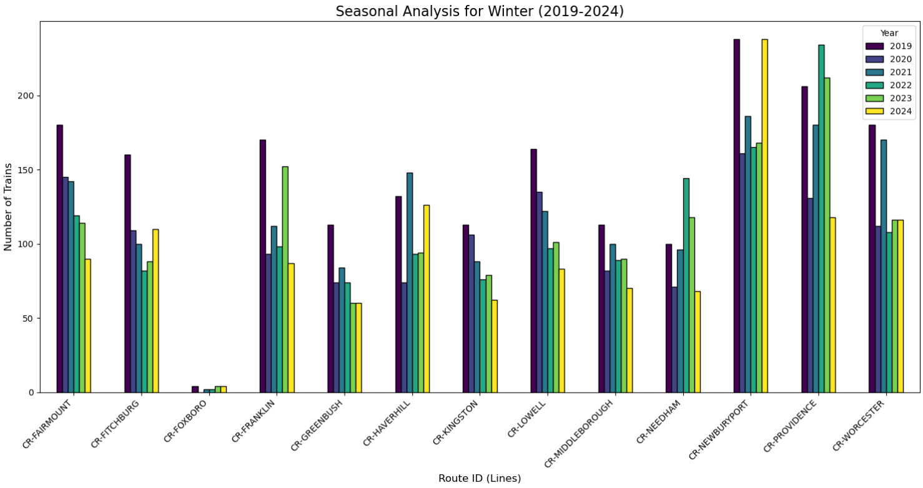
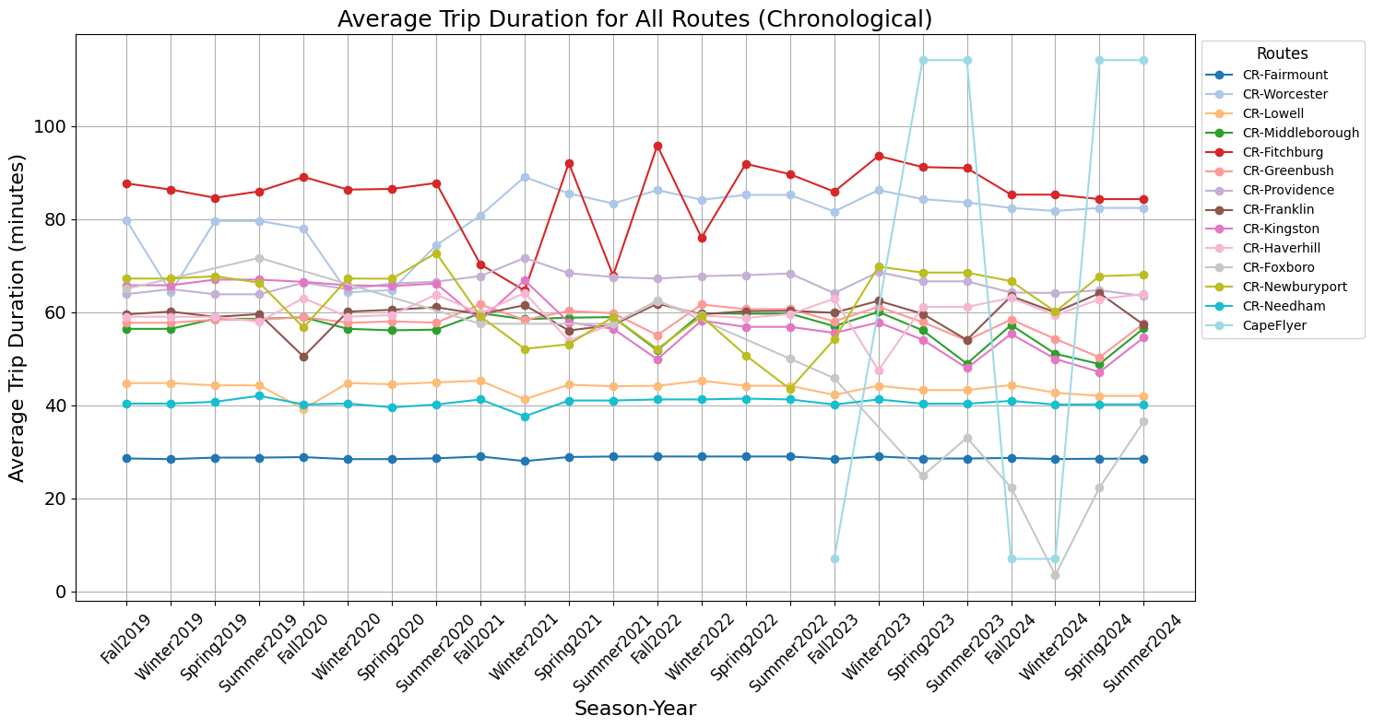
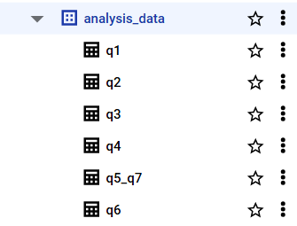
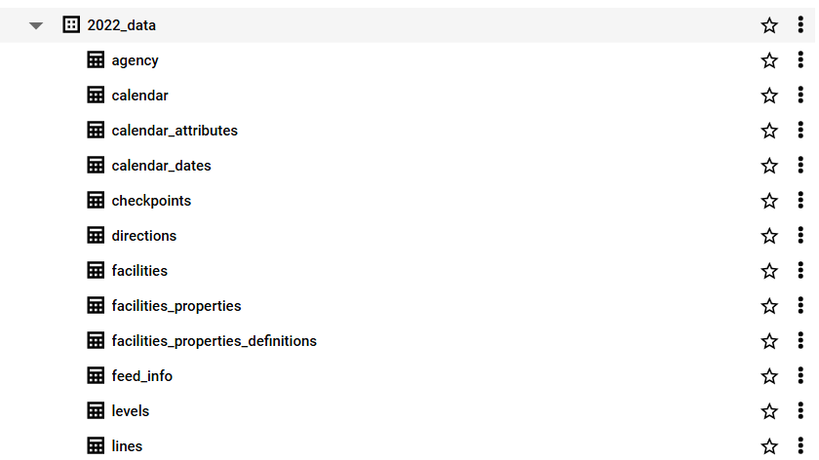
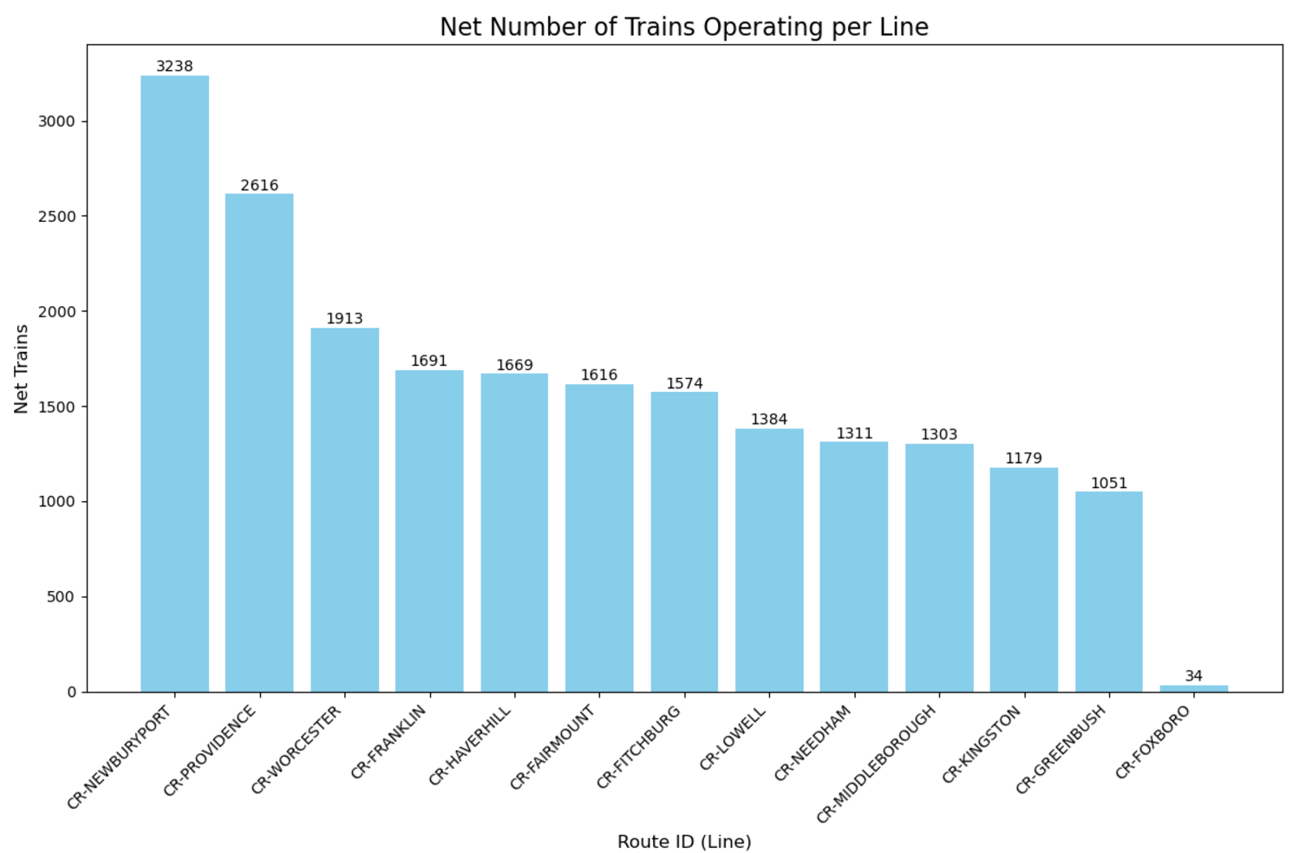
A Better City: Commuter Rail Analysis
By Bhuvan Shivalingaiah Gowda (bhuvansg@bu.edu)
Neel Gangrade
Ningxin Guan(nxguan@bu.edu)
Sumanth Hosdurg Kamath (sumanth@bu.edu)
Yuanchen Yin (yinthyg@bu.edu)
Data analysis
Pipeline to Upload the Answers for Key Questions on BigQuery
How have schedules shifted over time?
How do travel times vary across different schedules?
Here we see how the number of trips change through the years for the 4 seasons.
The bigquery_cleaned_pipeline.py script is used to upload the dataset corresponding to a specific base question to BigQuery under the analysis_data Dataset.
python3 bigquery_cleaned_pipeline.py --project ds-better-city-commuter --question_num q4
The possible values of the argument --question_num are 'q1', 'q2', 'q3', 'q4', 'q5', 'q6', 'q7', 'q8'.
Each question mentioned above has a table inside the analysis_data dataset.
This line gives us an ideas on how the trip duration for all the 14 routes change through the season years.
This analysis was carried out for every route in the dataset across multiple seasons and years. The results were stored in a new DataFrame containing columns for route_id, season_year, and the average trip duration.
These graph highlights the number of trains operating on each commuter rail line. Most lines show a steady increase in train numbers over the years. The highest values are consistently in 2024.The data reveals a positive trend in operations, with some lines growing faster than others. These changes likely result from evolving demand and adjustments in service.
The seasonal graph shows an increase in train numbers during fall for most lines, especially in 2024. Declines in certain years, like 2020 and 2021. These changes likely result from evolving demand and adjustments in service under the influence of COVID-19.
What is the net number of trains operating per line?
Conclusion
Reference
The approach provided an accurate representation of train operations. It also highlighted the total number of distinct trips on each line. The results give a clear understanding of train usage across the network.
This analysis offers valuable insights for planning and resource allocation. It supports future improvements in commuter rail services.
Developing scripts to automatically fetch data.
Visualization of MBTA schedule data.
BigQuery pipeline for non-technical client to access data easily.
Detailed tutorial and accompanying transition document detailing how others may self-serve data for future analyses.
Further analyze the relationship between trip counts and ridership demand to support decarbonization
Boston Globe Spotlight Team. (2019, November 19). Seeing red: A special report by the Boston Globe Spotlight Team. The Boston Globe. Retrieved from https://apps.bostonglobe.com/metro/investigations/spotlight/2019/11/19/seeing-red/
A Better City. (2018, January 29). The transportation dividend: How investments in transportation infrastructure pay off for Massachusetts. Retrieved from https://www.abettercity.org/assets/images/Transportation%20Dividend%20-%20FINAL%20-%20012918.pdf

